Slide 1

Writing your own container in Python
Shubham Sharma
shubhamsharma1172@gmail.com

Slide 2
But what is a Container?
Containers 101
Python + Containerization
Containerization with Linux
Modern containers
source: Wikipedia
Notes:
Credits to FewBytes, Liz Rice and Julian Friedman

Slide 3
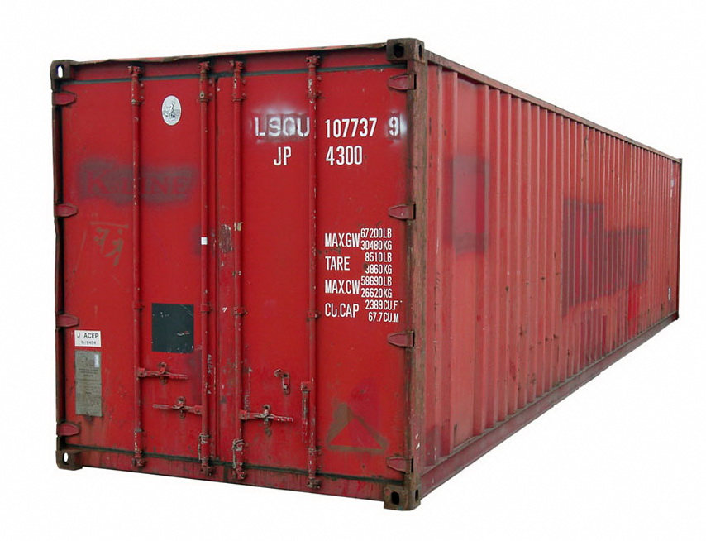
Containers 101
Isolated environment
Lightweight VM
Umm, dockers?
Notes:
https://www.docker.com/resources/what-container

Slide 4
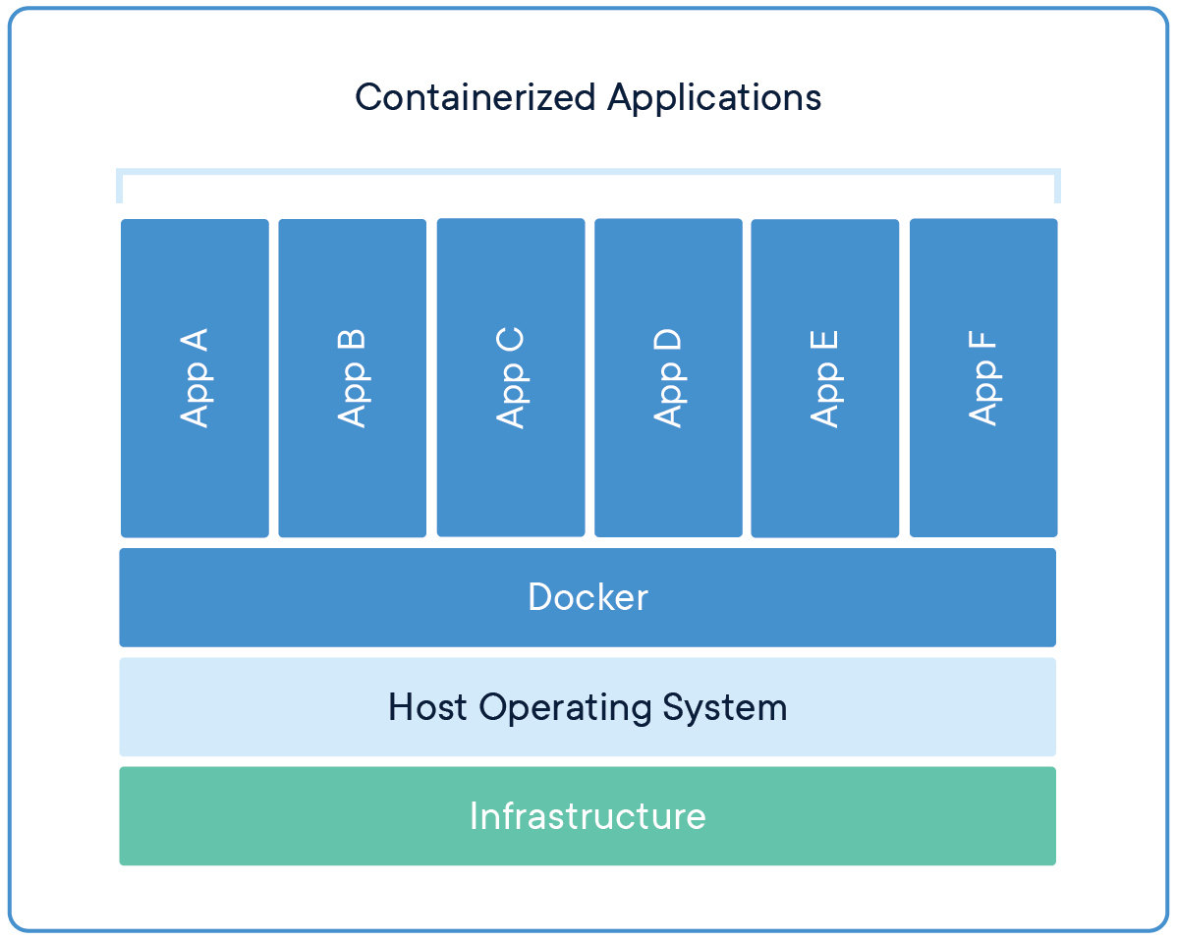
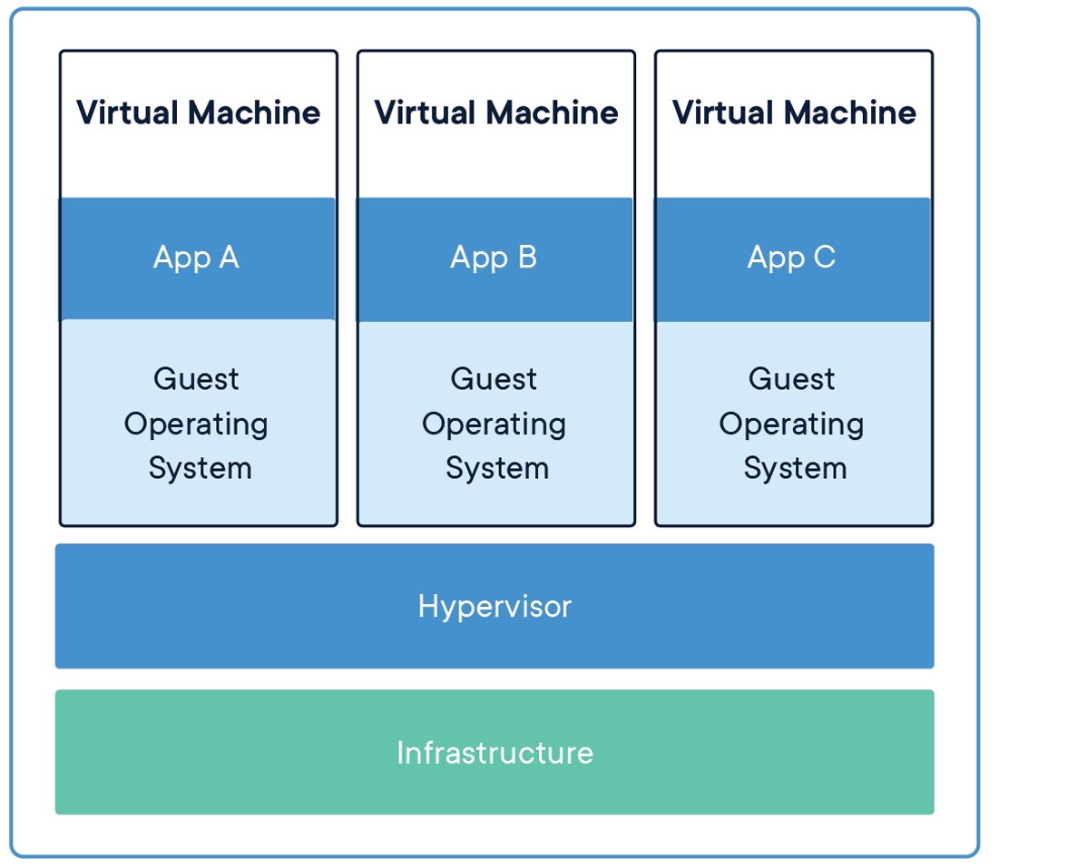
https://www.docker.com/resources/what-container

Slide 5
>> import container
Python + Containerization
Notes:
Time for coding

Slide 6
Containerization with Linux

Slide 7
Namespaces
- Mount (mnt)
- Process ID (PID)
- Network (net)
- Interprocess Communication (IPC)
- Unix Timesharing System (UTS)
- User
- Cgroups
Notes:
What you can see

Slide 8
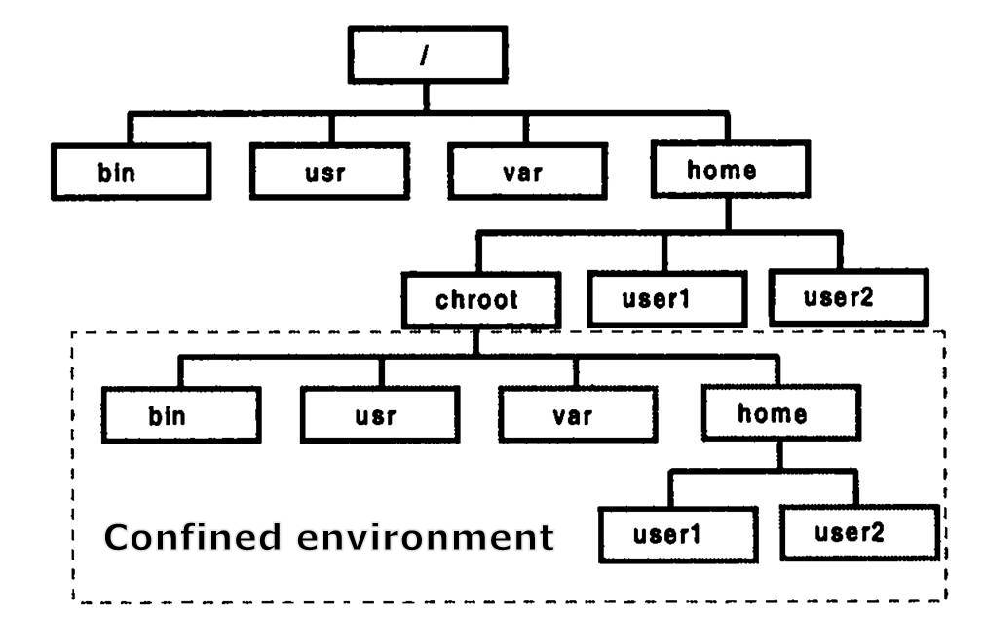
Chroot
Jailing a process
source: http://albertomatus.com/changing-working-root-directory/
Notes:
What you can see

Slide 9
Cgroups
- CPU
- Memory
- Network
- Devices
- I/O
- Monitoring
Notes:
What you can use

Slide 10
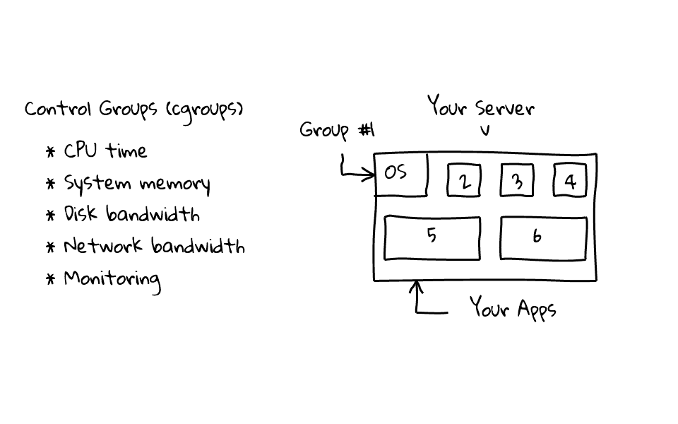
source: sysadmincasts.com
Notes:
What you can use

Slide 11
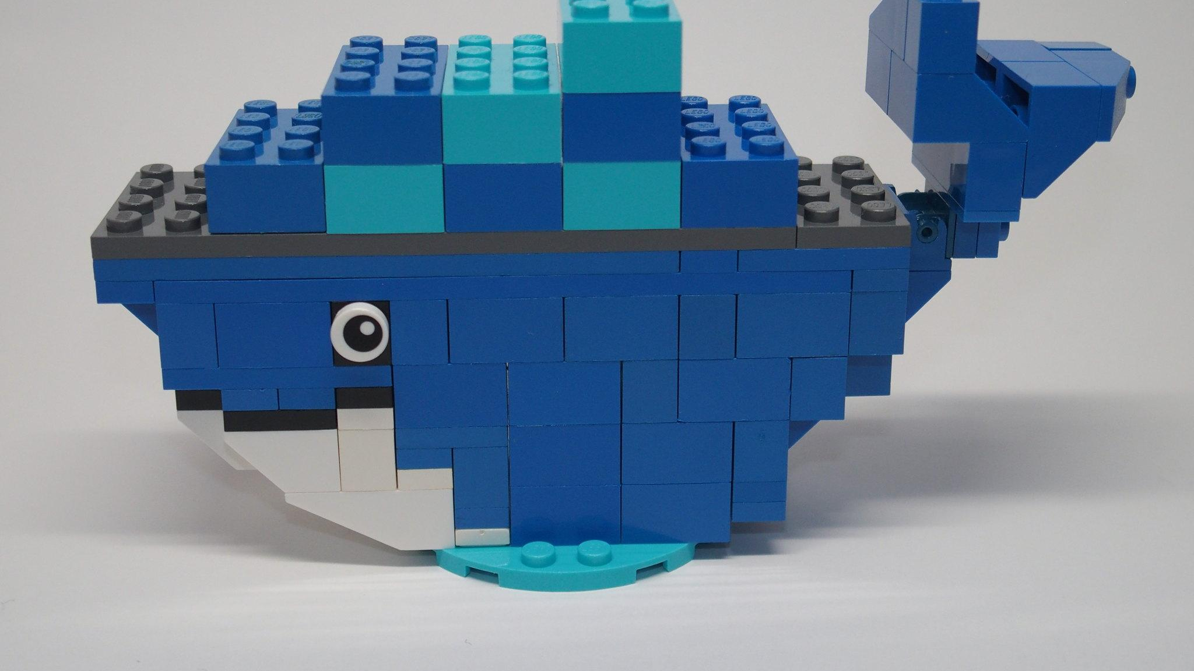
Modern Containers
source: flickr

Slide 12
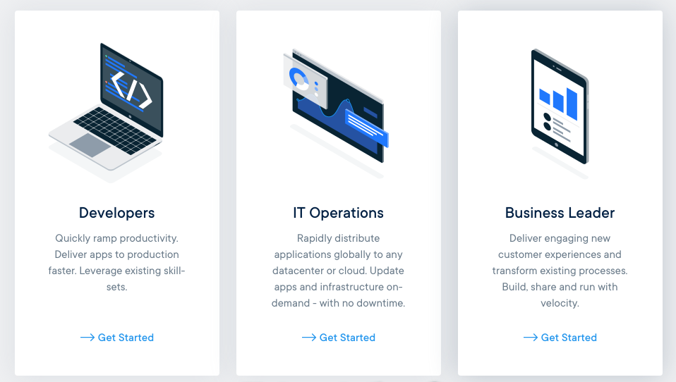
Dockers
Modern day container standard
source: docker

Slide 13
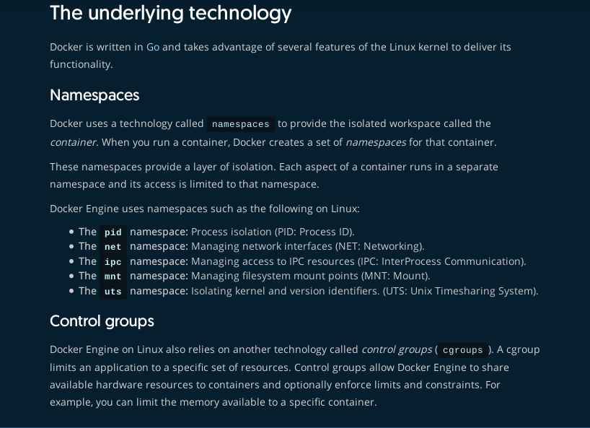
From the source
https://docs.docker.com/engine/docker-overview/#the-underlying-technology

Slide 14
Supporting material
Man pages chroot, namespaces, cgroups
Namespaces in operation - lwn.net
Pocket - GitHub
Rubber Docker (Container in Python) - GitHub
Liz Rice (Container Camp) - YouTube
Julian Friedman’s article - Infoq

Slide 15

Reach out
Mail: shubhamsharma1172@gmail.com
GitHub: shubham1172
LinkedIn: shubham1172

Slide 16
Thank you.

